Slide 1
Weahther reporting app

Slide 2
TEAM MEMBERS
p.sai sankar
K.Bala Naga Venkat
M.Raviteja
G.Hemanth kumar
G.Pavan Venkata Sai

Slide 3
Software requriments
1.Tkinter
2.Requests
3.Time
4.Jupyter notebook

Slide 4
Weather reporting app:
weather forcasting apps are very important because they are used to protect life and property in disaster prone areas.
Since outdoor activities are severely curtailed by heavy rains, snow and wind etc, forecasts can be used to plan activities around the disasters and plan ahead them and survive from them.
Wind ,relative humidity, temperature ,rainfall and air mass stability are the most important element to consider.
The goal of weather prediction is to provide information to people and organizations can use it to provide information around and help people in disastarous circamustances and enhances social benefits.
Including protection of life and property, public life and health safety. And also supports of economic prosperity and quality of life. Weather is the state of atmosphere . Describing for example the degree to wheather it is hot or cold or wet or dry calm or strong.

Slide 5
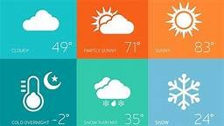
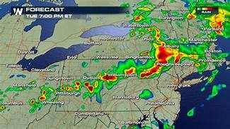

Slide 6
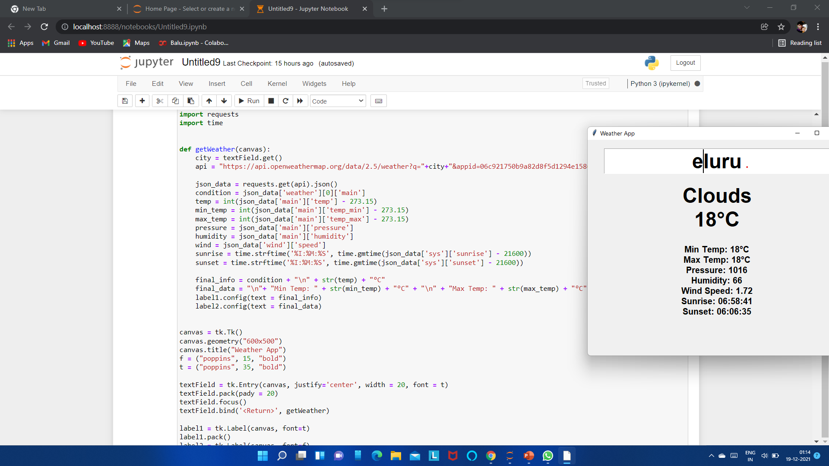

Slide 7


